Slide 1
Unit 203: Electrical installations technology
Conduit systems

Slide 2
Conduit systems
Three main types:
metal (steel)
PVC
flexible.

Slide 3
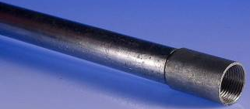
Steel conduit systems
Advantages:
affords conductors good mechanical protection
permits easy rewiring
minimises fire risks
can be utilised as the circuit protective conductor.
Disadvantages:
under certain conditions, moisture is liable to form on the inside of the conduit
expensive compared with some other systems
liable to corrosion when subject to acid, alkali and other fumes.

Slide 4
Steel conduit systems
Types of steel conduit finish:
galvanised for outdoors or situations where steam or dampness is present.
black enamelled for general work in dry situations.
Typical sizes (diameters):
16mm
20mm
25mm
32mm
available in 3.75 metre lengths.

Slide 5
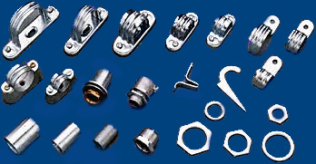
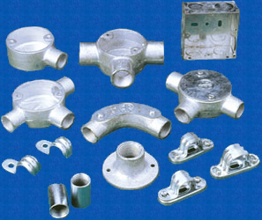
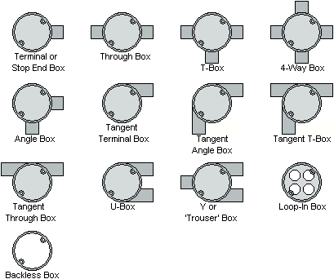
Steel conduit systems

Slide 6
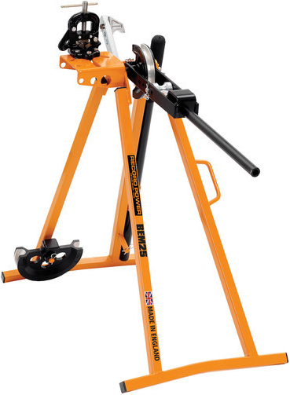
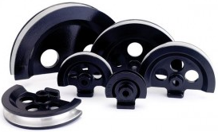
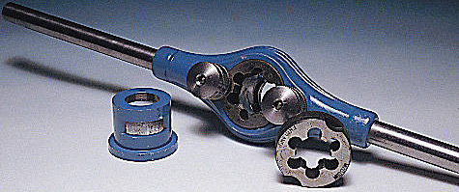
Steel conduit systems
Specialist steel conduit tools
Formers
Bending machine
Stocks and dies

Slide 7
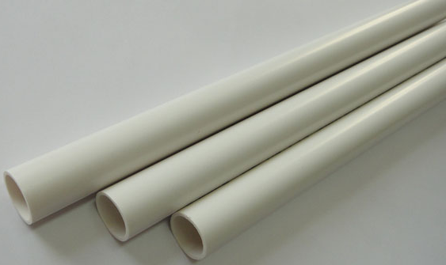
PVC conduit systems
Advantages:
light in weight and easy to handle
easy to saw, cut and clean
simple to form and bend
does not require painting
minimal condensation due to low thermal conductivity in walls
speed of erection
excellent electrical and fire resistant properties.
Disadvantages:
care must be taken when gluing joints to avoid forming a barrier across the inside of the conduit
if insufficient adhesive is used the joints may not be waterproof
pvc expands around five times as much as steel and this expansion must be allowed for.

Slide 8
PVC conduit systems
Types of PVC conduit:
Heavy Gauge Super High Impact: Designed to withstand arduous site conditions and extreme weather conditions. Major building contractors and government departments often specify this type of conduit for use.
Light Gauge Super High Impact: Suitable for pre-cast and in situ concrete work.
Heavy Gauge Standard Impact: Suitable for typical conduit installations.
Heavy Gauge High Temperature Material: Suitable for installations where 80/85°C temperatures are expected.
Typical sizes:
16, 20, 25, 32, 38 and 50mm diameter
in 3 metre lengths.

Slide 9
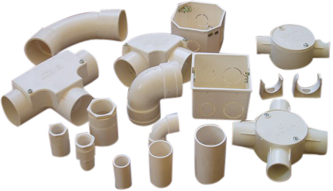
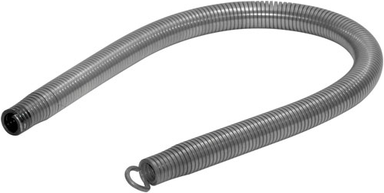
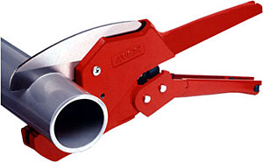
PVC conduit systems

Slide 10
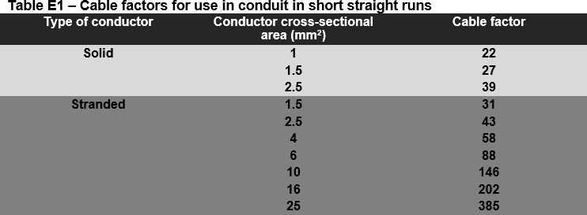
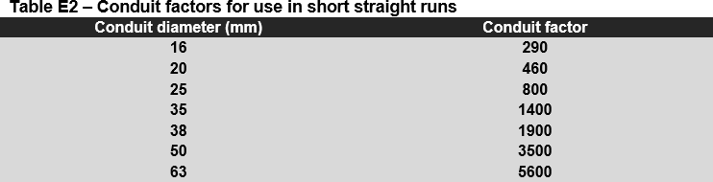
Sizing conduit systems
Short straight runs

Slide 11
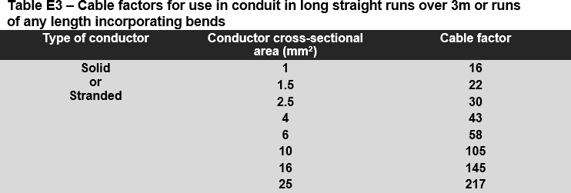
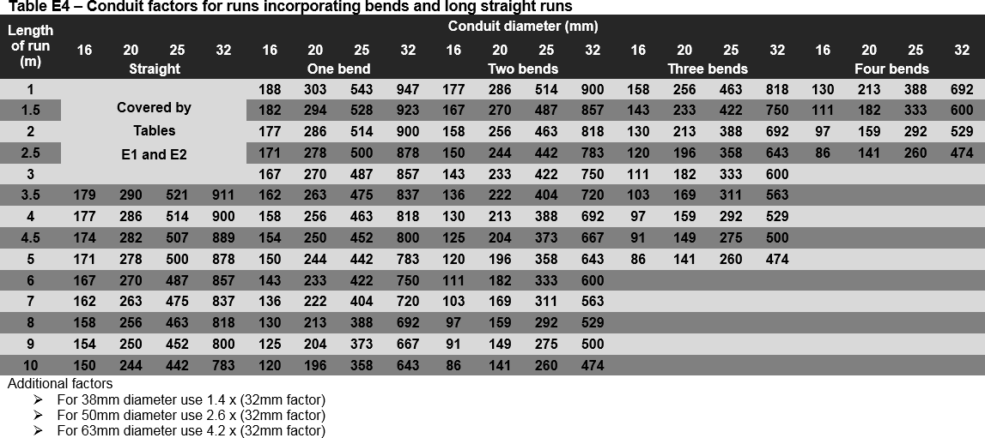
Sizing conduit systems
Long straight runs or runs with bends

Slide 12
Sizing conduit systems
Example 1. The following cables are to be drawn into a straight 2m length of conduit:
2 off solid core 1.5mm²
4 off solid core 2.5mm²
4 off stranded 4mm².
Calculate the conduit size required to accommodate these cables.

Slide 13
Sizing conduit systems
Example 1. The following cables are to be drawn into a straight 2m length of conduit:
2 off solid core 1.5mm²
4 off solid core 2.5mm²
4 off stranded 4mm².
Calculate the conduit size required to accommodate these cables.
Cable factors from Table E1 (On-Site Guide)
2 off solid core 1.5mm² | = | 27 x 2 | = | 54
4 off solid core 2.5mm² | = | 39 x 4 | = | 156
4 off stranded 4mm² | = | 58 x 4 | = | 232
Cable factors total | = | 54 + 156 + 232 | = | 442
From On-Site Guide Table E2, size required | = | 20mm

Slide 14
Sizing conduit systems
Example 2. The following cables are to be drawn into a 2m length of conduit with 2 bends:
2 off solid core 1.5mm²
4 off solid core 2.5mm²
4 off stranded 4mm².
Calculate the conduit size required to accommodate these cables.

Slide 15
Sizing conduit systems
Example 2. The following cables are to be drawn into a 2m length of conduit with 2 bends:
2 off solid core 1.5mm²
4 off solid core 2.5mm²
4 off stranded 4mm².
Calculate the conduit size required to accommodate these cables.
Cable factors from Table E3 (On-Site Guide)
2 off solid core 1.5mm² | = | 22 x 2 | = | 44
4 off solid core 2.5mm² | = | 30 x 4 | = | 120
4 off stranded 4mm² | = | 43 x 4 | = | 172
Cable factors total | = | 44 + 120 + 172 | = | 336
From On-Site Guide Table E4, size required | = | 25mm

Slide 16
Unit 203: Electrical installations technology
The End

